Slide 1

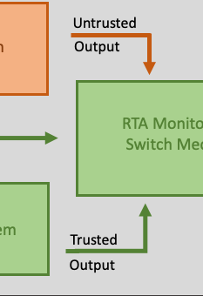
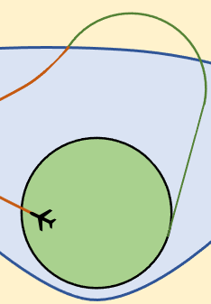

Formally Verifying Run-time Assurance
2nd Quarter Verification & Validation
Research Transition Team Meeting
June 28th, 2023
J Tanner Slagel
NASA Langley Research Center

Slide 2
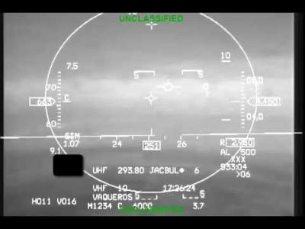
F-16 Close Call 5/5/16
[1]: Source, NASA Armstrong: https://www.youtube.com/watch?v=aSzXqlnT7nQ&embeds_euri=https%3A%2F%2Fwww.nasa.gov%2F&source_ve_path=MjM4NTE&feature=emb_title
Notes:
Hey Everyone welcome, let's start by watching a video This video is of a F-16 in 2016 almost crashing just a spoiler alert it doesn't crash and the pilot ends up being fine:
Alright so what did we just see. This video is of the HUD display of a student pilot from the Arizona Air National Guard’s 152nd Fighter Squadron, and the pilot executes a maneuver and because of the resulting 8.2 G forces the Pilot loses consciousness
About 11 seconds later the F-16 is pointed 50 degree below the horizon, going a little over the speed of sound at 11.8 thousand feet. In this situation the 'floor' is 12,000 feet which is considered the minimal acceptable altitude for the F-16 to be at.
Four seconds later the aircraft is at 8570 feet, so lost about 3500 feet in 4 seconds, and the AUTO-GCAS system activates, performing a 'Fly UP' maneuver at where it takes control of the F-16 while the pilot is incapacitated. The maneuver results in a force of 9.1 Gs, but it pulls the noise of the F-16 up and eventually the pilot recovers and the F-16 gets back above the 'floor' of 12,000 ft.
So Auto-Gcas eps the the automatic ground collision avoidance system that has been developed over several decades for situations like these, developed by Lockheed Martin and NASA Armstrong and the Airfare research laboratory not by my be at all). And what we just saw is an example of this technology saving a pilot's life.

Slide 3
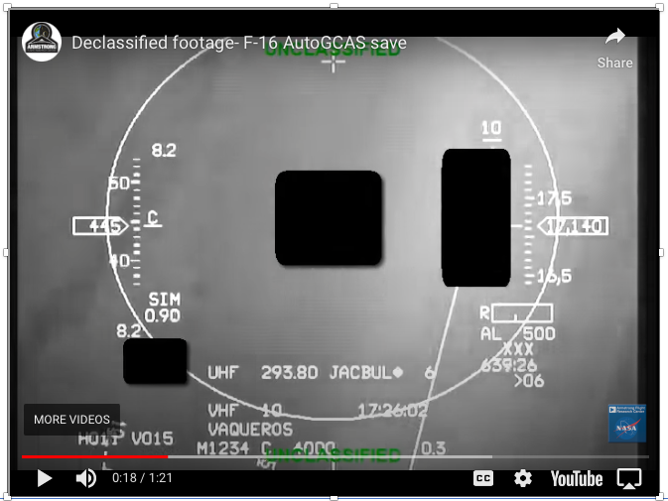
F-16 Close Call 5/5/16
Play-by-play
8.2 G Maneuver
18
Pilot loses
consciousness
29
33
38
41
65

Slide 4
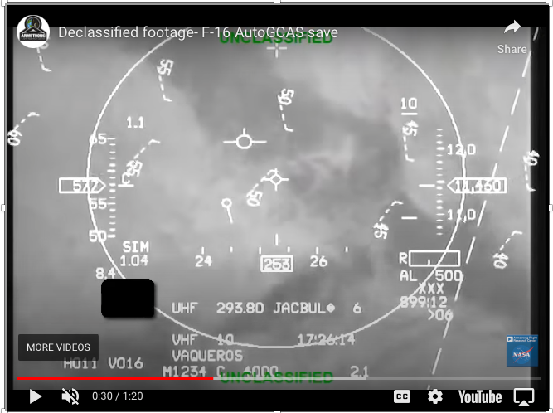
F-16 Close Call 5/5/16
Play-by-play
8.2 G Maneuver
18
Pilot loses
consciousness
30
Drops below ‘floor’
33
38
41
65

Slide 5
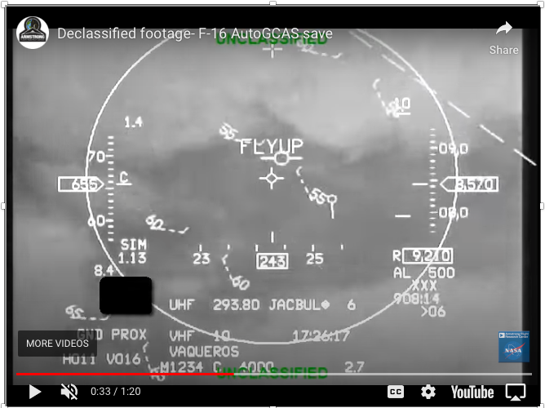
F-16 Close Call 5/5/16
Play-by-play
8.2 G Maneuver
18
Pilot loses
consciousness
29
Drops below ‘floor’
33
55º below horizon
Auto-GCAS
Activates
38
41
65
[2]: Auto GCAS, Lockheed Martin: https://www.lockheedmartin.com/en-us/products/autogcas.html

Slide 6
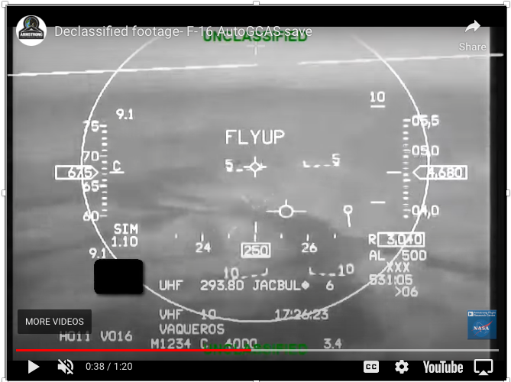
F-16 Close Call 5/5/16
Play-by-play
8.2 G Maneuver
18
Pilot loses
consciousness
29
Drops below ‘floor’
33
55º below horizon
Auto-GCAS
Activates
38
9 G maneuver
41
65

Slide 7
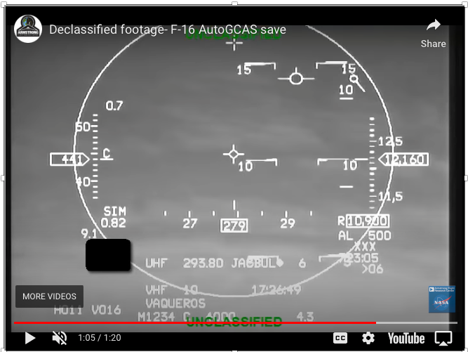
F-16 Close Call 5/5/16
Play-by-play
8.2 G Maneuver
18
Pilot loses
consciousness
29
Drops below ‘floor’
33
55º below horizon
Auto-GCAS
Activates
38
9 G maneuver
41
Back above ‘floor’
65

Slide 8
Runtime Assurance (RTA)
Untrusted
Advanced System
Output
Trusted
System
Being
Controlled
Input
RTA Monitor &
Switch Mechanism
Allocator
Output
Reversionary System
Trusted
Output
[2]: Runtime Assurance Framework Development For Highly Adaptive Flight Control Systems, SBIR Phase III Report, J.D. Schierman et. al. https://apps.dtic.mil/dtic/tr/fulltext/u2/1010277.pdf

Slide 9
Runtime Assurance (RTA)
Untrusted
Classficiation (NN)
System
Output
Trusted
System
Being
Controlled
Input
RTA Monitor &
Switch Mechanism
Allocator
Output
Human Operator
checking
Trusted
Output
[2]: Runtime Assurance Framework Development For Highly Adaptive Flight Control Systems, SBIR Phase III Report, J.D. Schierman et. al. https://apps.dtic.mil/dtic/tr/fulltext/u2/1010277.pdf

Slide 10
Auto-GCAS
Untrusted
Human Pilot
Output
Input
RTA Monitor &
Switch Mechanism
Trusted
Flying an
F-16
Allocator
Output
Auto-GCAS
Trusted
Output
[3]: Run-Time Assurance: A Rising Technology, J. G. Fuller, 2020 DASC https://ieeexplore.ieee.org/document/9256425

Slide 11

Geofenced Operations
Reversionary System
Advanced System

Slide 12
Geofenced Operations
Untrusted
Complex Path
Output
Operating a
fix-winged
aircraft
Input
RTA Monitor &
Switch Mechanism
Allocator
Return to safe zone dynamics
Trusted
Output
[4]: Runtime Assurance for Safety-Critical Systems: An Introduction to Safety Filtering Approaches for Complex Control Systems, K. L. Hobbs et. al. https://arxiv.org/pdf/2110.03506.pdf

Slide 13
How do we model and analyze these systems at design time?
Geofenced Operations
Untrusted
Complex Path
Output
Operating a
fix-winged
aircraft
Input
RTA Monitor &
Switch Mechanism
Allocator
Return to safe zone dynamics
Trusted
Output
[4]: Runtime Assurance for Safety-Critical Systems: An Introduction to Safety Filtering Approaches for Complex Control Systems, K. L. Hobbs et. al. https://arxiv.org/pdf/2110.03506.pdf

Slide 14
Hybrid Programs and Differential Dynamic Logic

Slide 15
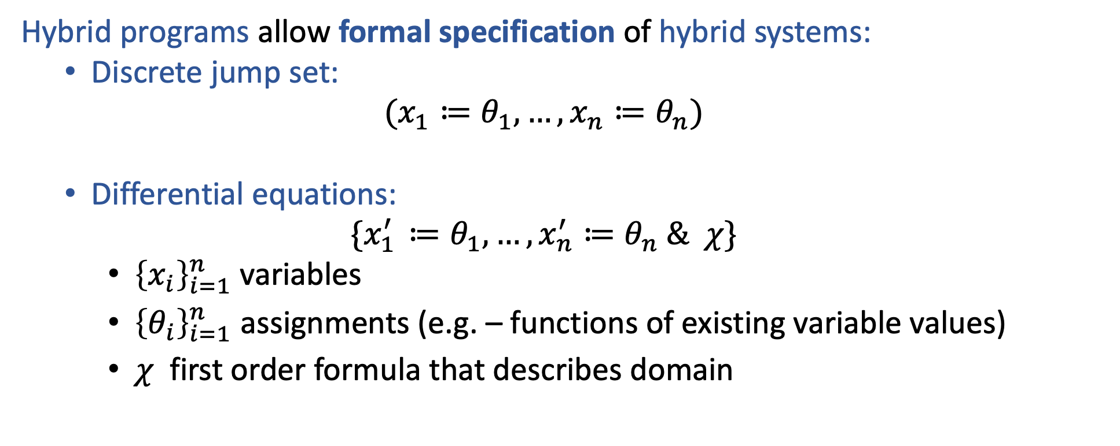
Hybrid Programs
Hybrid programs allow formal specification of hybrid systems:
Discrete jump set:
$$(x_{1}≔θ_{1}, …, x_{n}≔θ_{n})$$
Differential equations:
$$\{x_{1^{ }}^{′}≔θ_{1}, …, x_{n}^{′}≔θ_{n} \& χ\}$$
${\left\{x_{i}\right\}}_{i=1}^{n}$ variables
${\left\{θ_{i}\right\}}_{i=1}^{n}$ assignments (e.g. – functions of existing variable values)
$χ$ first order formula that describes domain
Example:
$$\left(x≔0^{ }, y≔c^{ }\right);\left\{x^{′}=y, y^{′}=−x \& y≥0\right\}$$

Slide 16

Hybrid Programs
$$y$$
$$c^{ }$$
$$x$$
Example:
$$\left(x≔0^{ }, y≔c^{ }\right);\left\{x^{′}=y, y^{′}=−x \& y≥0\right\}$$

Slide 17

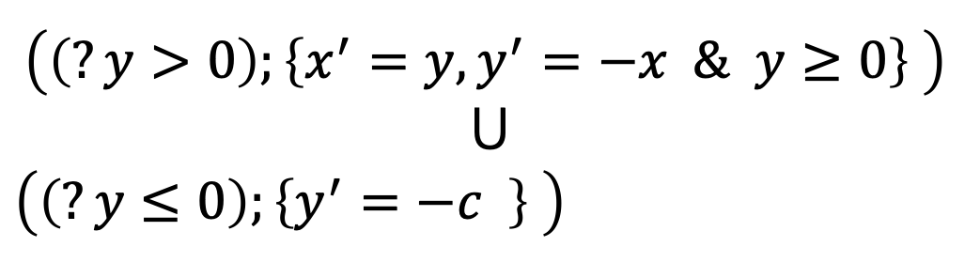
Hybrid Programs (continued)
For hybrid programs $Hp_{1}$, $Hp_{2}$, first-order formula $χ$:
Choice $\left(Hp_{1}∪Hp_{2}\right)$
Sequence $\left(Hp_{1};Hp_{2}\right)$
Repeat ${\left(Hp_{1}^{ }\right)}^{∗}$
Test $\left(?χ\right)$
$${\left(\left(?y>0\right);\left\{x^{′}=y, y^{′}=−x \& y≥0\right\} \right)}^{ }$$
$$⋃$$
${\left(\left(?y≤0\right);\left\{y^{′}=−c^{ } \right\} \right)}^{ }$
*
Example:

Slide 18
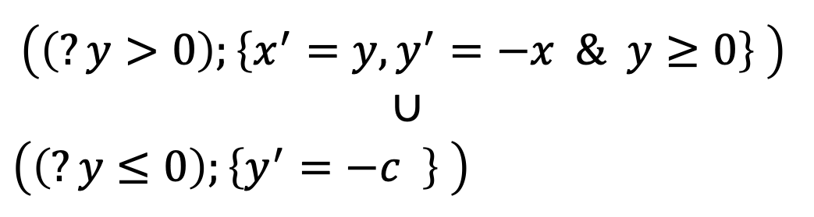


Hybrid Programs (continued)
$$y$$
$$c^{ }$$
$$x$$
$${\left(\left(?y>0\right);\left\{x^{′}=y, y^{′}=−x \& y≥0\right\} \right)}^{ }$$
$$∪$$
${\left(\left(?y≤0\right);\left\{y^{′}=−c^{ } \right\} \right)}^{ }$
*
Example:

Slide 19
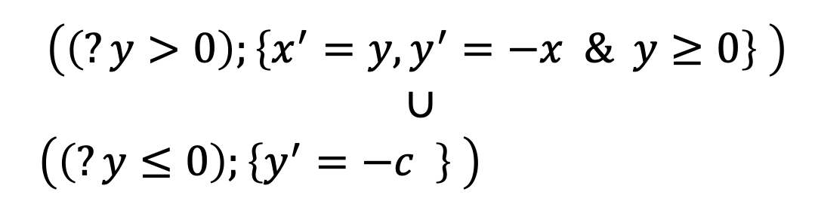
Hybrid Programs (continued)
$$y$$
$$c^{ }$$
$$x$$
$${\left(\left(?y>0\right);\left\{x^{′}=y, y^{′}=−x \& y≥0\right\} \right)}^{ }$$
$$∪$$
${\left(\left(?y≤0\right);\left\{y^{′}=−c^{ } \right\} \right)}^{ }$
*
Example:

Slide 20

Hybrid Programs (continued)
$$y$$
$$c^{ }$$
This is a Dubins path!
$$x$$
$${\left(\left(?y>0\right);\left\{x^{′}=y, y^{′}=−x \& y≥0\right\} \right)}^{ }$$
$$∪$$
${\left(\left(?y≤0\right);\left\{y^{′}=−c^{ } \right\} \right)}^{ }$
*
Example:

Slide 21
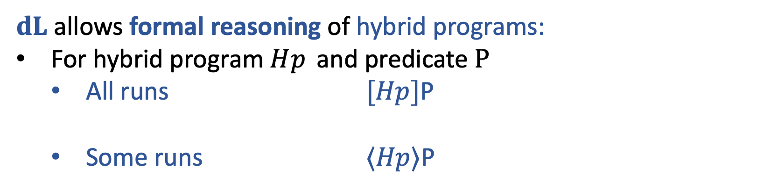



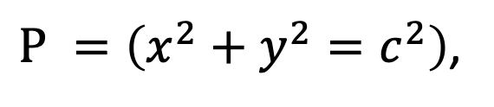
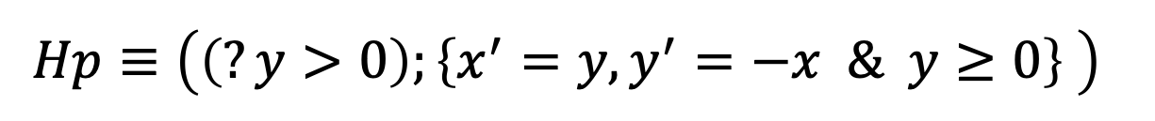
$dL$: Differential Dynamic Logic
$dL$allows formal reasoning of hybrid programs:
For hybrid program $Hp_{ }$ and predicate $P$
All runs $[Hp]$P
Some runs $⟨Hp⟩$P
Example: Let
$${Hp≡{\left(\left(?y>0\right);\left\{x^{′}=y, y^{′}=−x \& y≥0\right\} \right)}^{ }}^{ }$$
$P^{ }=\left(x^{2}+y^{2}=c^{2}\right)$,
then
$y=c^{ },x=0→\left[Hp\right]P$
$y=c^{ },x=0→⟨Hp⟩(y=0)$

Slide 22




$dL$: Differential Dynamic Logic
$$y$$
$$c^{2}$$
$$x$$
Example: Let
$${Hp≡{\left(\left(?y>0\right);\left\{x^{′}=y, y^{′}=−x \& y≥0\right\} \right)}^{ }}^{ }$$
$P^{ }=\left(x^{2}+y^{2}=c^{2}\right)$,
then
$y=c^{ },x=0⊢\left[Hp\right]P$
$y=c^{ },x=0⊢⟨Hp⟩(y=0)$

Slide 23


$dL$: Differential Dynamic Logic – Rule Schema
Union axiom:
Loop rule:
Differential invariant
rule:
….and many more${! }^{[4]}$
[5] Differential Dynamic Logic, Logical Foundations of Cyber-Physical Systems. André Platzer. 2018 https://doi.org/10.1007/978-3-319-63588-0
[6] $dL$ “Cheat Sheet,” André Platzer, https://symbolaris.com/logic/dL-sheet.pdf

Slide 24

$dL$: Proof
Differential invariant
rule:
$$y=c^{ },x=0 ⊢[{\{x}^{′}=y, y^{′}=−x\}](x^{2}+y^{2}=c^{2})$$
[5] Differential Dynamic Logic, Logical Foundations of Cyber-Physical Systems. André Platzer. 2018 https://doi.org/10.1007/978-3-319-63588-0
[6] $dL$ “Cheat Sheet,” André Platzer, https://symbolaris.com/logic/dL-sheet.pdf

Slide 25

$dL$: Proof
Differential invariant
rule:
$$y=c^{ },x=0 ⊢[{\{x}^{′}=y, y^{′}=−x\}](x^{2}+y^{2}=c^{2})$$
[5] Differential Dynamic Logic, Logical Foundations of Cyber-Physical Systems. André Platzer. 2018 https://doi.org/10.1007/978-3-319-63588-0
[6] $dL$ “Cheat Sheet,” André Platzer, https://symbolaris.com/logic/dL-sheet.pdf

Slide 26
$dL$: Proof
Differential invariant
rule:
$$y=c, x=0 ⊢x^{2}+y^{2}=c^{2}$$
$$⊢[x^{′}:=y, y^{′}:=−x](2 x^{ }x′+{2 y y′}^{ }=0)$$
Apply Di rule
$$y=c^{ },x=0 ⊢[{\{x}^{′}=y, y^{′}=−x\}](x^{2}+y^{2}=c^{2})$$
[5] Differential Dynamic Logic, Logical Foundations of Cyber-Physical Systems. André Platzer. 2018 https://doi.org/10.1007/978-3-319-63588-0
[6] $dL$ “Cheat Sheet,” André Platzer, https://symbolaris.com/logic/dL-sheet.pdf

Slide 27
$dL$: Proof
Differential invariant
rule:
$$⊢ {0^{2}}^{ }+{ c^{2} }^{ }=c^{2}$$
$$⊢2 x^{ }y+{2 y \left(−x\right)}^{ }=0$$
Apply
substitution
$$y=c, x=0 ⊢x^{2}+y^{2}=c^{2}$$
$$⊢[x^{′}:=y, y^{′}:=−x](2 x^{ }x′+{2 y y′}^{ }=0)$$
Apply Di rule
$$y=c^{ },x=0 ⊢[{\{x}^{′}=y, y^{′}=−x\}](x^{2}+y^{2}=c^{2})$$
[5] Differential Dynamic Logic, Logical Foundations of Cyber-Physical Systems. André Platzer. 2018 https://doi.org/10.1007/978-3-319-63588-0
[6] $dL$ “Cheat Sheet,” André Platzer, https://symbolaris.com/logic/dL-sheet.pdf

Slide 28

$dL$: Proof
Differential invariant
rule:
$$⊢0=0$$
Arithmetic!
$$⊢2 x^{ }y+{2 y \left(−x\right)}^{ }=0$$
$$⊢ {0^{2}}^{ }+{ c^{2} }^{ }=c^{2}$$
Apply
substitution
$$y=c, x=0 ⊢x^{2}+y^{2}=c^{2}$$
$$⊢[x^{′}:=y, y^{′}:=−x](2 x^{ }x′+{2 y y′}^{ }=0)$$
Apply Di rule
$$y=c^{ },x=0 ⊢[{\{x}^{′}=y, y^{′}=−x\}](x^{2}+y^{2}=c^{2})$$
[5] Differential Dynamic Logic, Logical Foundations of Cyber-Physical Systems. André Platzer. 2018 https://doi.org/10.1007/978-3-319-63588-0
[6] $dL$ “Cheat Sheet,” André Platzer, https://symbolaris.com/logic/dL-sheet.pdf

Slide 29

dL
Plaidypvs
[7] Towards an Implementation of Differential Dynamic Logic in PVS, SOAP 2022, Slagel et. al. https://dl.acm.org/doi/abs/10.1145/3520313.3534661
Notes:
Properly Assured Implementation of Differential Dynamic Logic from hybrid programs verification and specification

Slide 30
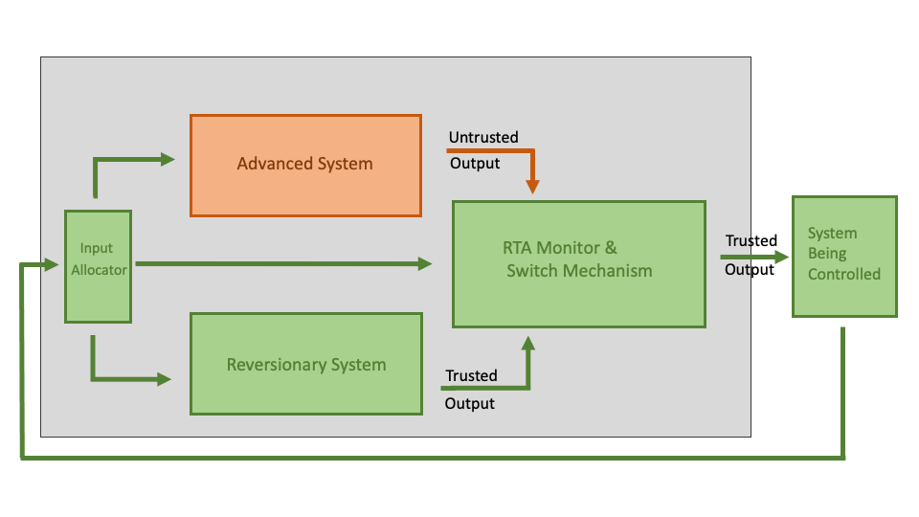
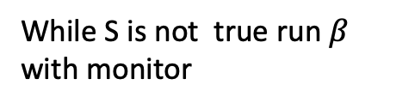
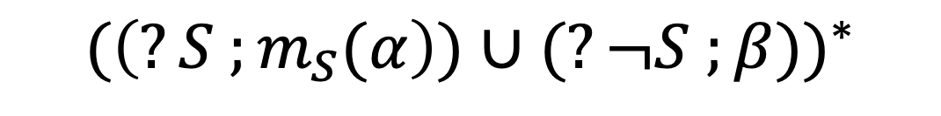
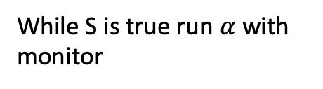



RTA in Plaidypvs
$$α$$
$$S, { m}_{s}$$
$$β$$
Example: Define
$${(\left(?S ;m_{S}(α\right))∪(?¬S ;β))}^{∗}$$
While S is true run $α$with monitor
and
While S is not true run $β$ with monitor

Slide 31
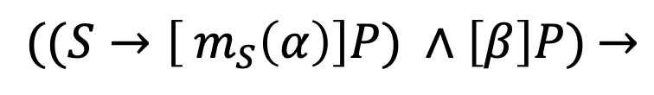
RTA in Plaidypvs
$$α$$
$$S, { m}_{s}$$
$$β$$
Example:
$${((S→\left[ m_{S}\left(α\right)\right]P) ∧\left[β\right]P)}^{ }→$$
$${[(\left(?S ;m_{S}(α\right))∪(?¬S ;β))}^{∗}] P$$
“If $α$ is safe in S and $β$ is always safe, then the RTA architecture is always safe”

Slide 32






Geofenced Operations (simplified)
$$R$$
Reversionary System
Advanced System
$$Y$$
$$B$$
$$x^{′}=f_{x},$$
$$y^{′}=f_{y}$$
$$\begin{aligned}x^{′}=−w \left(y−y_{0}\right)+f_{0,x} \\ y^{′}=w \left(x−x_{0}\right)+f_{0,y }\end{aligned}$$
$$\frac{2\sqrt{2}v_{max}}{w}$$

Slide 33
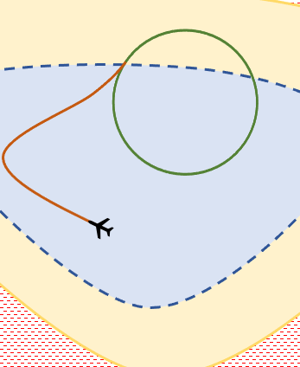






Geofence RTA
$${[(\left(?S ;m_{S}(α\right)∪(?¬S ;m_{S}(β)))}^{∗}] P$$
$${[(\left(?B ;{ m_{B}(α) }_{ }\right)∪(?¬B ; β))}^{∗}]¬R$$
“The aircraft never goes into the red region ”
$$x^{′}=f_{x},$$
$$y^{′}=f_{y}$$
$$α=$$
and
$$\begin{aligned}x^{′}=−w \left(y−y_{0}\right)+f_{0,x} \\ y^{′}=w \left(x−x_{0}\right)+f_{0,y }\end{aligned}$$
$$β=$$
$${bdry?\left(B\right)→⟨ (?¬B ; β))}^{∗}⟩B$$
“If the aircraft exits the blue region, it will
Eventually return to the blue region ”
$$B$$
$$\frac{2\sqrt{2}v_{max}}{w}$$
$$R$$
$$Y$$

Slide 34

Geofence RTA
$${[(\left(?S ;m_{S}(α\right)∪(?¬S ;m_{S}(β)))}^{∗}] P$$
$${[(\left(?B ;{ m_{B}(α) }_{ }\right)∪(?¬B ; β))}^{∗}]¬R$$
“The aircraft never goes into the red region ”
$$x^{′}=f_{x},$$
$$y^{′}=f_{y}$$
$$α=$$
and
$$\begin{aligned}x^{′}=−w \left(y−y_{0}\right)+f_{0,x} \\ y^{′}=w \left(x−x_{0}\right)+f_{0,y }\end{aligned}$$
$$β=$$
$${bdry?\left(B\right)→⟨ (?¬B ; β))}^{∗}⟩B$$
“If the aircraft exits the blue region, it will
eventually return to the blue region ”
$$B$$
$$\frac{2\sqrt{2}v_{max}}{w}$$
Not true!
$$R$$
$$Y$$

Slide 35


Geofence RTA
$${[(\left(?S ;m_{S}(α\right)∪(?¬S ;m_{S}(β)))}^{∗}] P$$
$${[(\left(?B ;{ m_{B}(α) }_{ }\right)∪(?¬B ; β))}^{∗}]¬R$$
“The aircraft never goes into the red region ”
$$x^{′}=f_{x},$$
$$y^{′}=f_{y}$$
$$α=$$
$${¬tgnt?\left(B\right)\left(f_{x},f_{y}\right)∧bdry?\left(B\right)}^{ }$$
$$\begin{aligned}x^{′}=−w \left(y−y_{0}\right)+f_{0,x} \\ y^{′}=w \left(x−x_{0}\right)+f_{0,y }\end{aligned}$$
$$β=$$
$${→⟨ {\left(?¬B ; β\right)}^{∗}⟩}^{ }B$$
“If the aircraft exits the blue region and is not tangent to the boundary of the blue region, it will eventually return to the blue region”
$$B$$
$$\frac{2\sqrt{2}v_{max}}{w}$$
$$R$$
$$Y$$

Slide 36

Summary
$${[(\left(?B ;{ α }_{ }\right)∪(?¬B ; β))}^{∗}]¬R$$
Plaidypvs can model and formally reason about RTA Systems
$$x^{′}=f_{x},$$
$$y^{′}=f_{y}$$
$$α=$$
$$\begin{aligned}x^{′}=−w \left(y−y_{0}\right)+f_{0,x} \\ y^{′}=w \left(x−x_{0}\right)+f_{0,y }\end{aligned}$$
$$β=$$
Example: If
$$B$$
$$\frac{2\sqrt{2}v_{max}}{w}$$
$$R$$
$$Y$$

Slide 37
Summary
$${[(\left(?B ;{ α }_{ }\right)∪(?¬B ; β))}^{∗}]¬R$$
Plaidypvs can model and formally reason about RTA Systems
$$x^{′}=f_{x},$$
$$y^{′}=f_{y}$$
$$α=$$
$$\begin{aligned}x^{′}=−w \left(y−y_{0}\right)+f_{0,x} \\ y^{′}=w \left(x−x_{0}\right)+f_{0,y }\end{aligned}$$
$$β=$$
Example: If
Thank you for paying attention!
$$B$$
$$\frac{2\sqrt{2}v_{max}}{w}$$
Questions, comments?
$$R$$
$$Y$$

Slide 38





Two Reversionary Systems
Advanced System
Untrusted
$$α$$
Trusted
Reversionary System 1
Monitor &
Switch Mechanism
$$β_{1}$$
System
Being
Controlled
Input
Allocator
$$S_{1},S_{2}$$
$$m_{s_{1}},m_{s_{2}}$$
Reversionary System 2
$$β_{2}$$

Slide 39
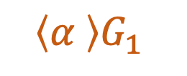
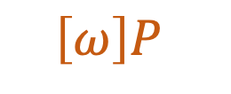

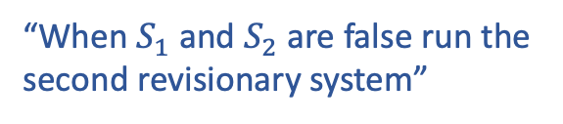
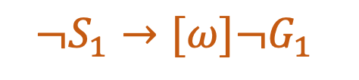
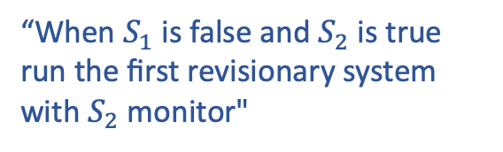
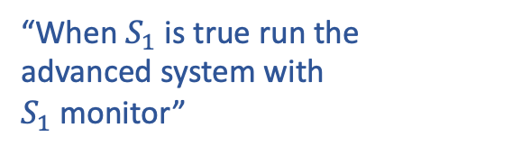
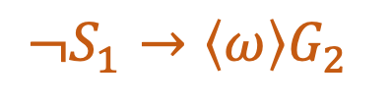
$S_{1}$ Property that causes switch from advanced to reversionary system 1
${m_{S_{1}}}_{ }$Monitor for $S_{1}$
$S_{2}$ Property that causes switch from reversionary system 1 to reversionary system 2.
${m_{S_{2}}}_{ }$ Monitor for $S_{2}$
P Safety Property
$G_{1}$, $G_{2}$Primary and secondary
Specification of system:
Assuming $S_{1}$ and $S_{2}$ only switch one way (represent irreversible failures)
$$ω{= (\left(?S_{1};{ m_{S_{1}}(α) }_{ }\right) ∪ \left(?¬S_{1}∧S_{2} ; {m_{S_{2}}(β}_{1})\right) ∪ (?¬S_{1}∧{¬S}_{2} ; β_{2}))}^{∗}$$
“When $S_{1}$ is true run the advanced system with $S_{1}$monitor”
“When $S_{1}$ is false and $S_{2}$ is true run the first revisionary system with $S_{2}$ monitor"
“When $S_{1}$ and $S_{2}$ are false run the second revisionary system”
Specifying properties of system
$$\left[ω\right]P$$
$$\left\langle α \right\rangle G_{1}$$
$$¬S_{1}→\left\langle ω\right\rangle G_{2}$$
$$¬S_{1}→[ω]{¬G}_{1}$$
“This ‘two reversionary system’ always maintains the safety property P”
“The advanced system will complete the primary goal”
“If the advanced system fails the system will still complete the secondary goal”
“If the advance system fails, the system will never complete its primary goal”

Slide 40
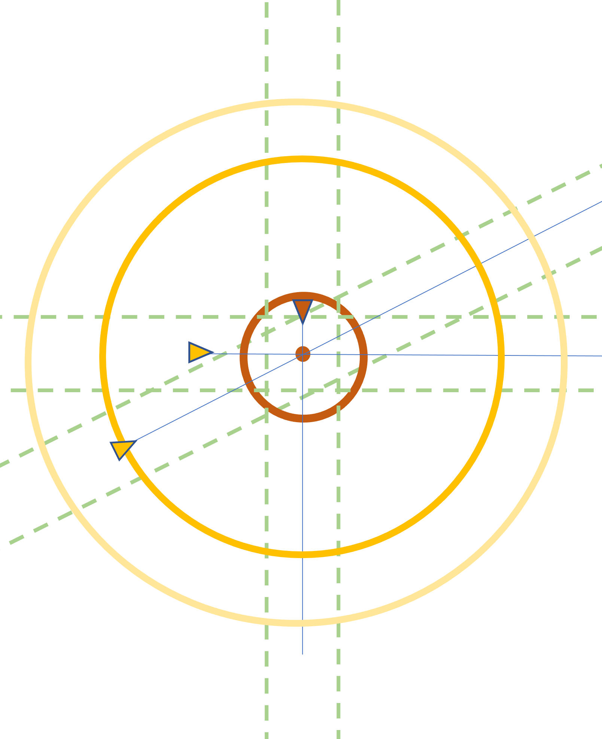


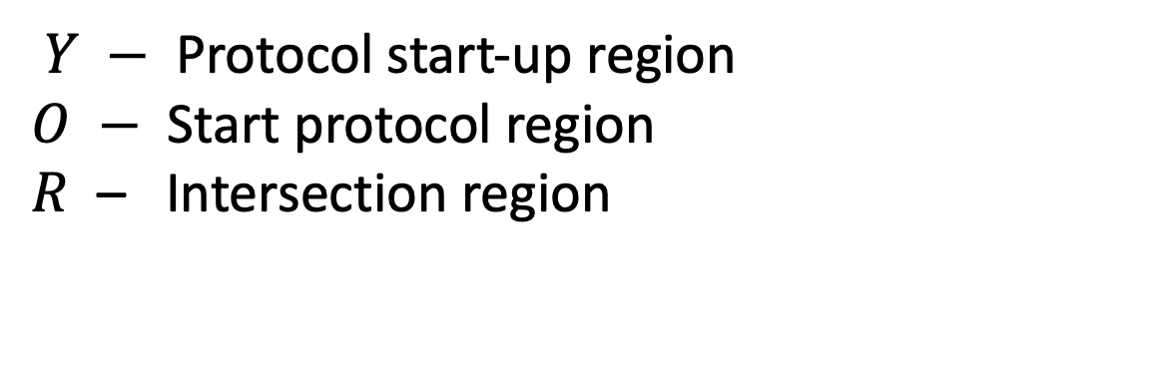
Intersection Protocol
$${[(\left(?S ;m_{S}(α\right)∪(?¬S ;m_{S}(β)))}^{∗}] P$$
$$x=\left[ x_{1}, x_{2}, …x_{n}\right]$$
positions of aircraft
$Y −$ Protocol start-up region
$O −$ Start protocol region
$R$ – Intersection region
$${[P(Y,O,x))]}^{ }{no}_{2}(R,x)$$
“If aircraft merge through the intersection with the protocol, no two will be within the intersection area at any time ”

Slide 44
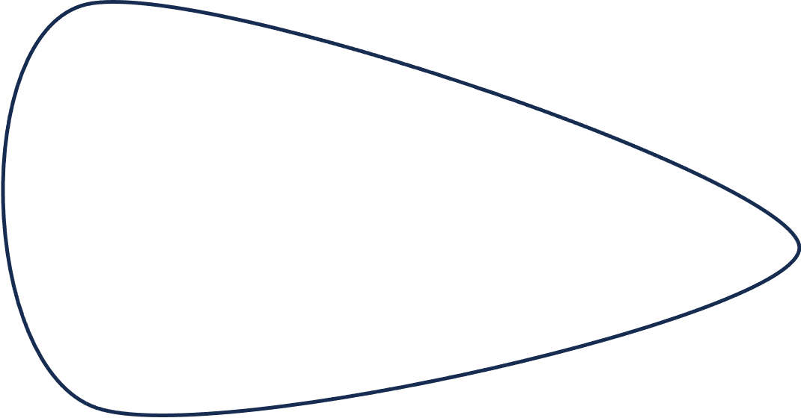

Fundamental Theorem of RTA

